Slide 1
Education in Bogotá
Analysis of education level in Bogotá schools
Sebastian Leiva
Matteo Negri
Paolo Trifilio
Luca Tramacere

Slide 2



Dataset description
Main variables
Features
Mean scores of the final exam in schools of Bogotà overall and by subject.
Geographical information
School coordinates
Neighborhood
School – specific information
Number of students
Public or private
Type of educational program
Rating
Reading Math Social Studies
Science English

Slide 3

Goals of the project
The Mayor of Bogotá is planning to invest in a new school and has asked for our help to identify the best conditions to maximize the mean score of the students on the final test.
We want to analyse:
Spatial dependence of the overall score and of each subject’s score
How the specific characteristics of the schools influence both the average score and also subject-wise
If the rating of the preceding year is actually a good measure of the school prestige

Slide 4
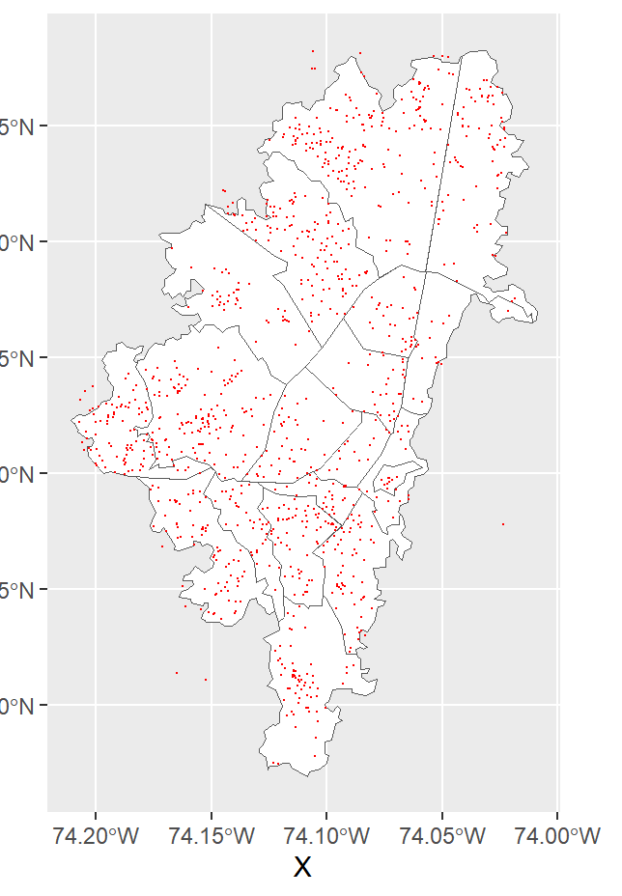
Our data
IDEAS?

Slide 5
Depth measures and outlier detection
Bogotà schools are very different from each other: there are e.g big schools and very small schools, so we wanted to see whether or not there were some extreme values in the scores of the single subjects. To be more precise, we identified as outliers only those schools who were identified as outliers in the majority of the bagplots
INSERT GRAPH, DISCUSS THE TABLE

Slide 6
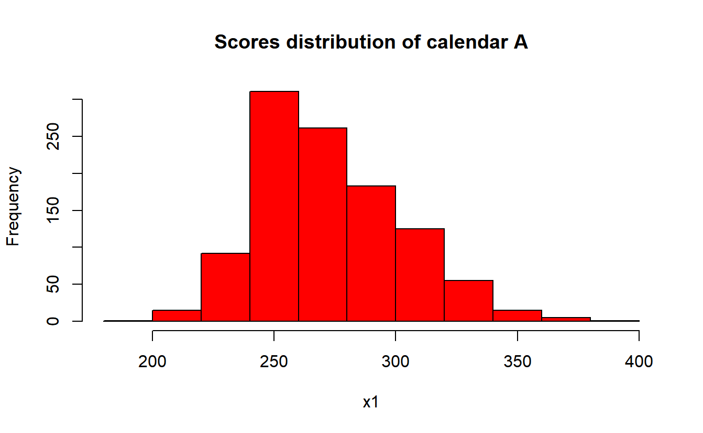
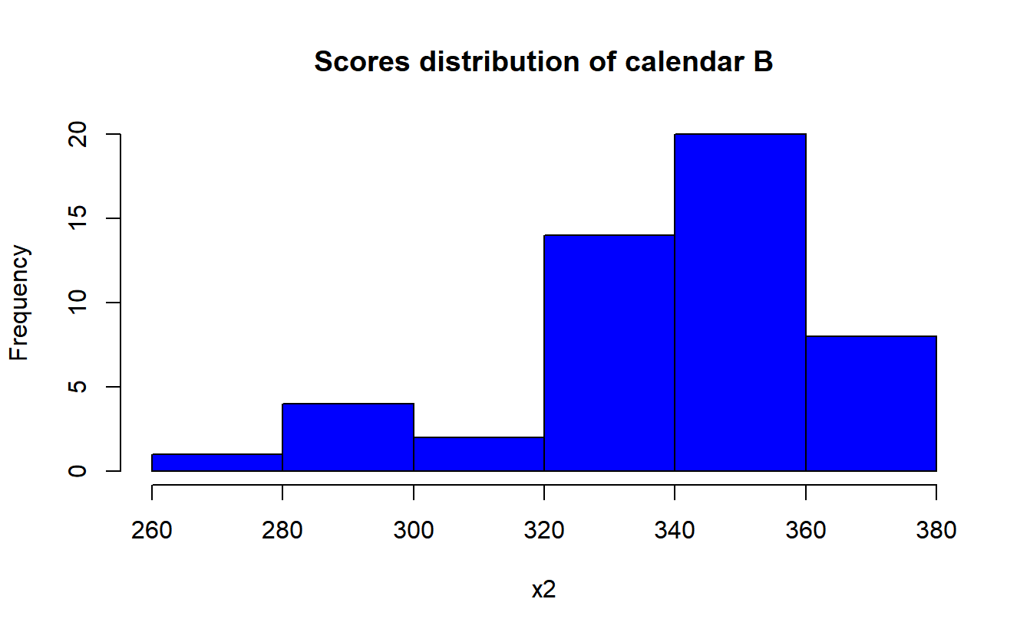
Nonparametric Inference - 1
Permutation T – test => Scores from different calendars have different distribution
Wilcoxon test for non-paired data => the median score of calendar B is greater than the median score of calendar A
Schools starting the year in August perform better than those starting the year in January

Slide 7
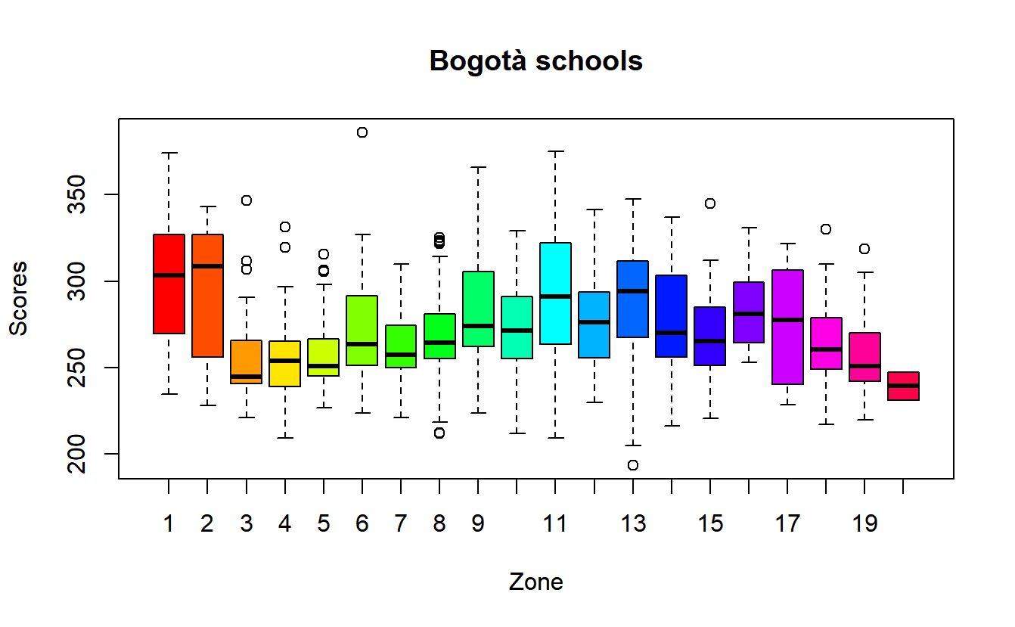
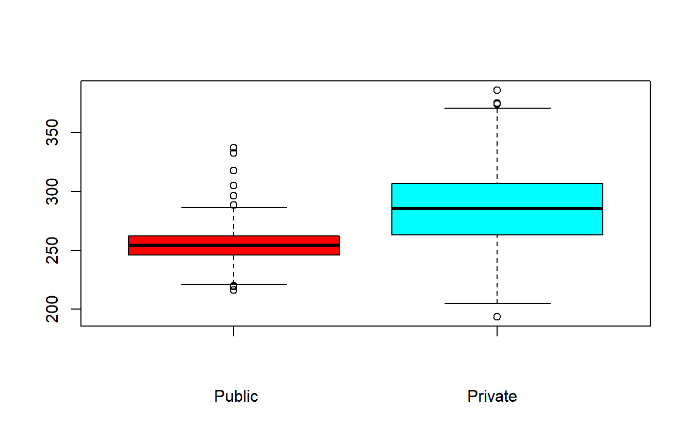
Nonparametric inference – 2
A rank tests confirms that scores in public schools are different form scores in private schools
A Wilcoxon test shows that private schools perform better than private schools
A permutational ANOVA confirms that scores in different zones of the city are different

Slide 8
Nonparametric Inference - 3
We already saw in the outlier detection that very small schools and big schools seemed to make a difference. We wanted to be sure that the variable «Evaluados» had an actual impact on the scores, so we performed a permutational regression
The answer was positive, yet we saw that the effect is far from being linear
INSERT GRAPH

